Slide 1

Project: Intelligent Document Retrieval
Meet our dedicated team behind the scenes:
Sukhesh Chittanuri -RA2211026010171
Jami Jaswanth -RA2211026010173
Reddy Lakshmi Manoj -RA2211026010179
Thottamsetti Chatush Raj -RA221102601053

Slide 2


Developing a Chat-Based Document Retrieval System
This project outlines the key steps involved in creating an intelligent chat- based system that can retrieve relevant information from a collection of documents. By leveraging natural language processing (NLP) and neural network models, we aim to build a user-friendly interface that allows users to seamlessly find the answers they need.

Slide 3


Requirement Analysis
1
Understand User Needs
Conduct interviews and surveys to gather insights into the specific information requirements of your target users. This will help you design a system that truly meets their needs.
2
Define Use Cases
Outline the various scenarios in which users might interact with the system, such as searching for relevant documents, getting answers to specific questions, or exploring related content.
3
Specify Performance Metrics
Determine the key performance indicators (KPIs) that will be used to measure the system's effectiveness, such as response accuracy, user satisfaction, and query response time.
4
Ensure Scalability
Design the system to handle growing volumes of documents and user requests without compromising performance or reliability.

Slide 4

Project Dataset Overview
Our project dataset includes several well-known collections for building robust question-answering systems:
SQuAD (Stanford Question Answering Dataset): This dataset from Stanford University focuses on reading comprehension, making it great for training QA models and benchmarking different systems.
Natural Questions (NQ): Provided by Google, this dataset contains real- world user queries and answers, helping us handle diverse, real-world questions.
MS MARCO: Sourced from Microsoft, this dataset includes real-world search queries and answers, which can improve search engine optimization and contextual understanding.
TriviaQA: This challenging dataset of trivia questions and answers will help us build general knowledge-based QA capabilities and handle complex queries.
By leveraging these high-quality datasets, we can develop a robust, intelligent document retrieval system that meets the diverse needs of our users.

Slide 5
Data Collection and Preprocessing
Data Collection
Text Extraction
Data Cleaning
Gather a diverse set of documents, including PDFs, web pages, and other textual sources, that cover the relevant topics and information your users might need. Ensure that the dataset is representative and comprehensive.
Use tools like PyMuPDF and BeautifulSoup to extract the text content from the various document formats, ensuring that the data is in a clean, structured format suitable for further processing.
Apply text normalization techniques, such as removing stop words, handling spelling errors, and converting to a consistent format, to prepare the data for the machine learning models.

Slide 6

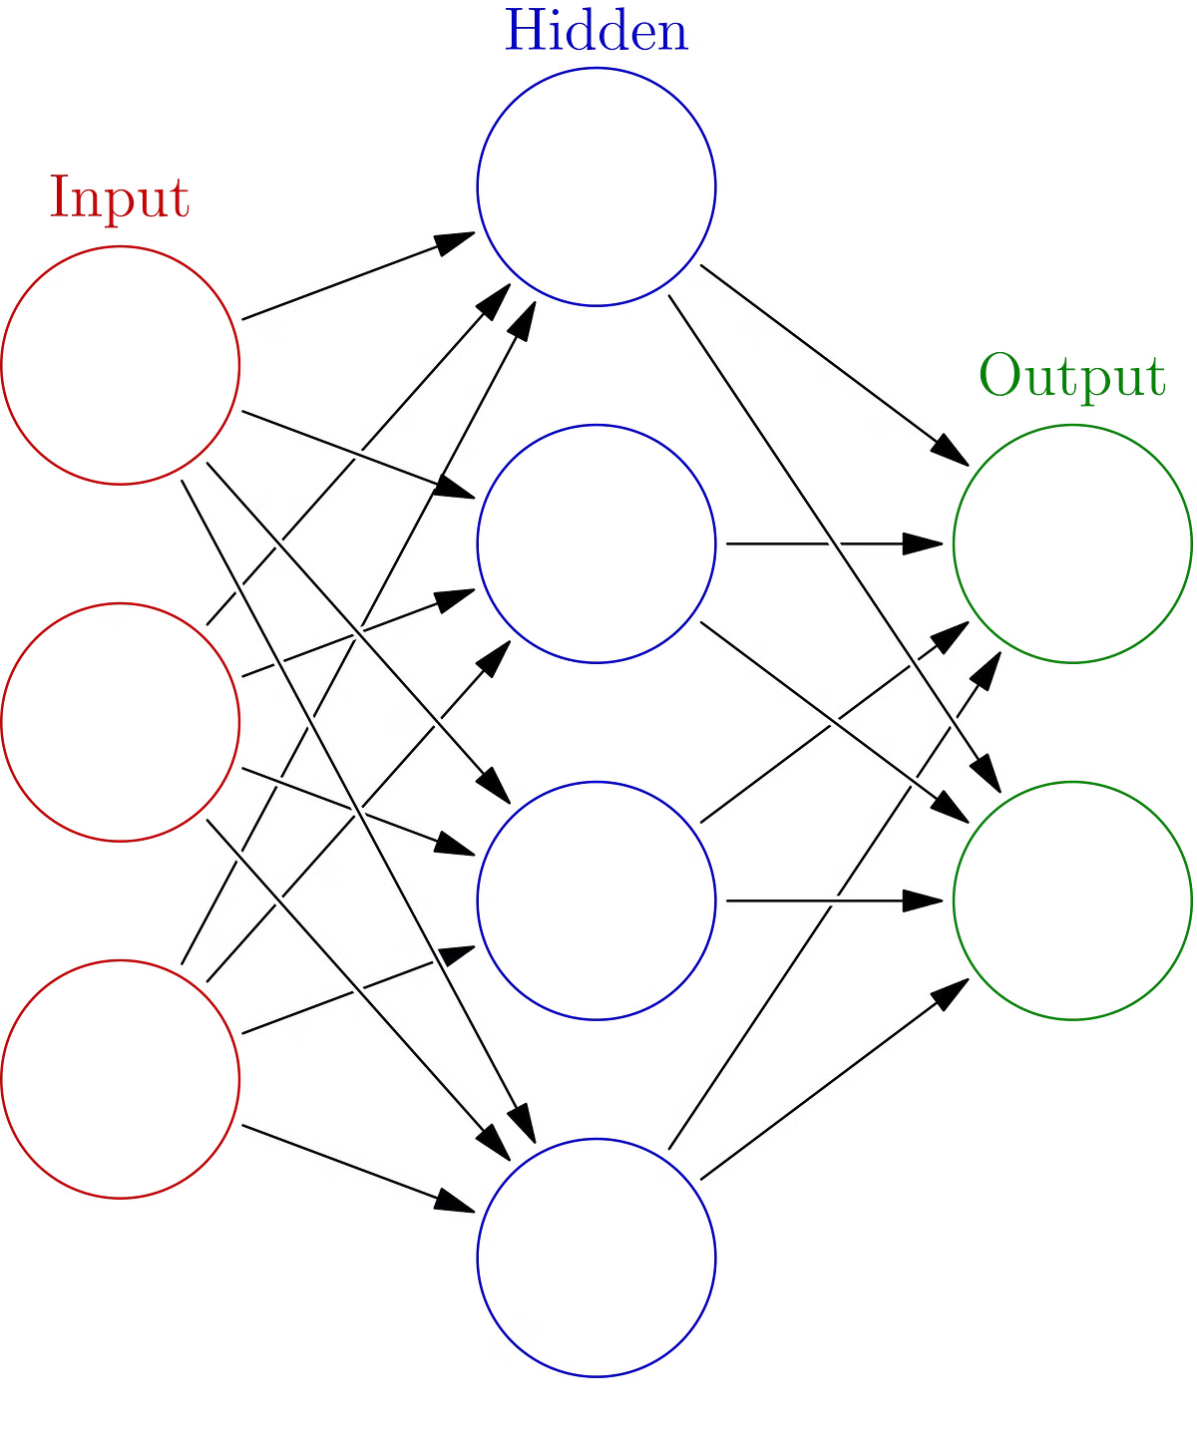
Model Selection and Training
1
Model Selection
Evaluate and choose an appropriate neural network model, such as BERT or GPT, that is well-suited for natural language understanding and question-answering tasks.
2
Dataset Preparation
Curate a high-quality training dataset that includes a diverse set of questions and their corresponding answers extracted from the collected documents.
3
Model Training
Fine-tune the selected model on the prepared dataset, optimizing hyperparameters and monitoring the model's performance on validation sets to ensure accurate retrieval of relevant information.

Slide 7

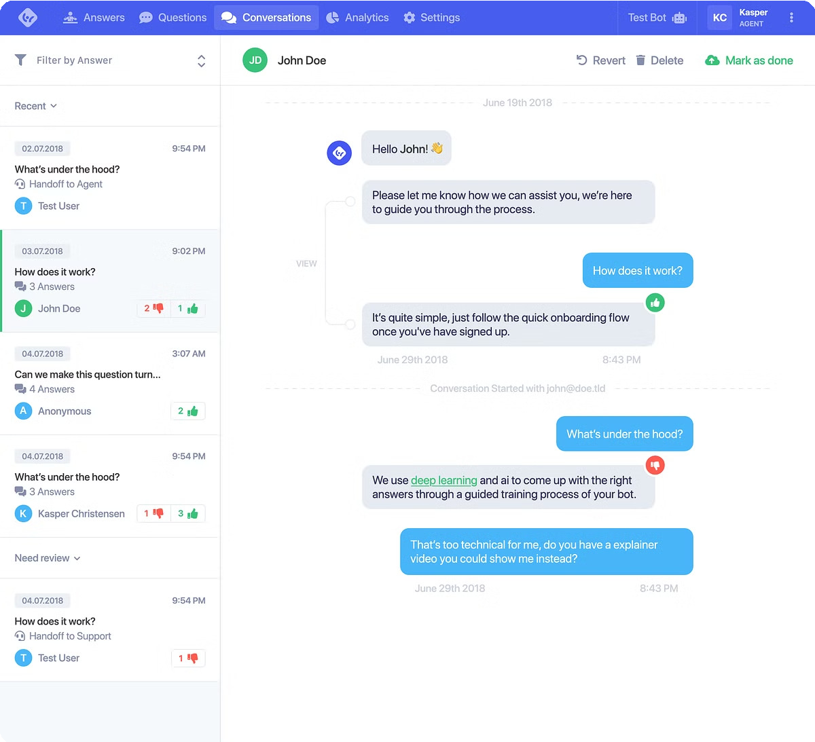
Integration and User Interface
Chat Interface
Develop a user-friendly chat interface that allows users to easily input their questions and receive the relevant information from the document collection. This can be implemented using web technologies like HTML, CSS, and JavaScript.
API Integration
Seamlessly integrate the trained NLP model with the chat interface, enabling the system to process user queries, retrieve the most relevant information, and present it to the user in a clear and concise manner.
Iterative Improvement
Continuously gather user feedback and monitor the system's performance to identify areas for improvement. Implement updates and refinements to enhance the user experience and the accuracy of the information retrieval.

Slide 8


Testing and Validation
Accuracy
Measure the system's ability to retrieve relevant information and provide accurate answers to user queries.
Response Time
Evaluate the system's performance in terms of the time it takes to process a user's question and deliver the response.
User Satisfaction
Collect user feedback and ratings to assess the overall satisfaction with the system's functionality and usability.
Scalability
Ensure the system can handle increasing volumes of documents and user requests without compromising performance.

Slide 9


Security and Privacy
Document Protection
Implement robust security measures to safeguard the documents and their content from unauthorized access or misuse.
1
User Data Privacy
Ensure that user queries and personal information are handled in compliance with data privacy regulations and best practices.
2
Auditing and Monitoring
Establish processes to regularly audit the system's security and privacy controls, and promptly address any identified vulnerabilities or compliance issues.
3

Slide 10
Continuous Improvement
Feedback Collection
Gather user feedback through surveys, usage analytics, and direct user interactions to identify areas for improvement.
Continuously fine-tune the NLP model, incorporating new data and feedback to enhance the system's accuracy and responsiveness.
Analyze user interactions and pain points to iteratively enhance the chat interface and overall user experience.
Deploy updates and monitor the system's performance to ensure it continues to meet the evolving needs of your users.
Model Refinement
User Experience Optimization
Deployment and Monitoring

